Slide 1
Cyclistic - Bike Share
Design Marketing Strategies Aimed at Converting Casual Riders into Annual Members.
Assem M. A. Fadl
10th of May, 2021

Slide 2
How do annual members and casual riders use Cyclistic bikes differently?
Business Task

Slide 3
Data Sources
A Bike share Company historical trip data
Data has been made available by Motivate International Inc.

Slide 4
Data Processing & Analysis
All Data Cleaning, Processing & Analysis has been done in R studio
Documentation of all these steps has been done using R Markdown.

Slide 5
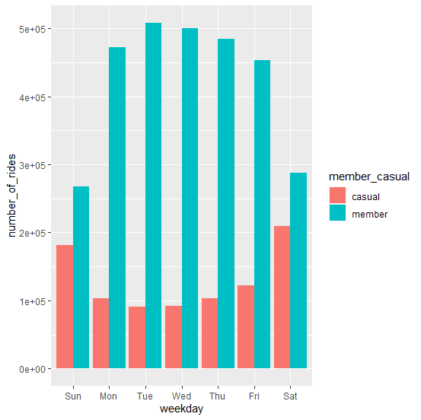
The Number of Rides for Annual Members and Casual Riders

Slide 6
In general, Annual Members have a higher number of rides than Casual Members

Slide 7
On working days (Monday to Friday) the Number of rides for Annual Members are almost triple the number of rides for Casual Members.
On Holidays (Saturday & Sunday) the number of rides for both are very close.

Slide 8
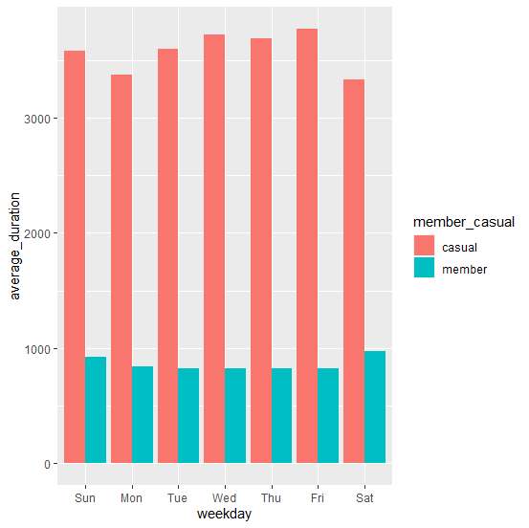
The Average Ride Duration for Annual Members and Casual Riders

Slide 9
The Average Ride Duration is almost 4 times greater in Casual Riders

Slide 10
Conclusion
1- The number of rides in Annual Members is very high on working days compared to Casual Members and is very close on Saturdays and Sundays.
2- The Average Ride Duration is much greater in Casual Riders throughout the week.

Slide 11
Recommendations
1- Create an annual Subscription for Saturdays, Sundays & Public holidays Only with a reduced price than the normal Annual subscription.
2- Increase Ad Campaigns targeting Casual riders on weekends and public holidays.
3- Address long distance riders in the Ad Campaigns and offer them discounts on annual memberships.

